Slide 1
Software
3
Chapter 3

Slide 2
SOFTWARE - TOPIC
System software
Features of System Software
Type of System Software
operating system
Utilities
Application software
The need for application software
Type of application software
Advantage and disadvantage of application software
Different between System Software and Application Software
Programming software
History of Programming software
Type of programming software
Component of programming software
Example of programming software
Malicious software

Slide 3
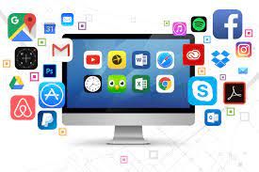
Introduction
Software is a set of instructions or code that directs computers and digital devices to perform specific tasks.
Makes hardware functional, enabling various applications.
Main type of software are:
System software
Application software
Programming software
Malicious software

Slide 4
System software

Slide 5
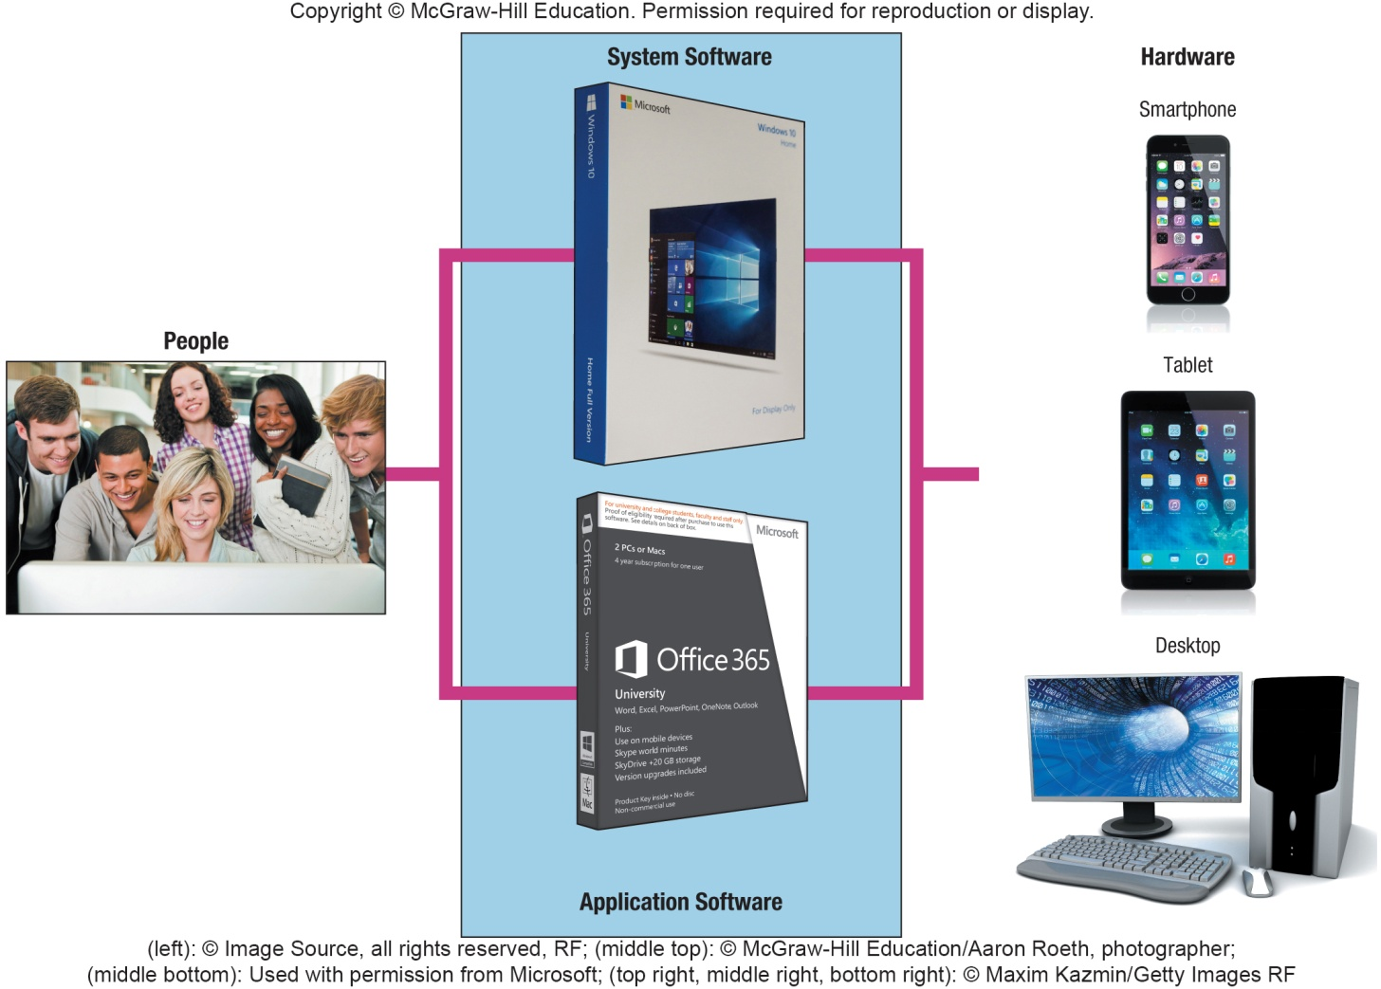
System Software
System software is a program designed to run a computer's hardware and applications and manage its resources :
memory
processors
devices.
It also provides a platform for running application software,
system software is typically bundled with a computer's operating system.
Notes:
System software (key term) is not a single program but is a collection of programs that handles hundreds of technical details
End-users focus on application programs more than the system software, but it is important to understand how system software works
Four types of programs:
Operating systems (key term) coordinate computer resources
Utilities (key term) perform tasks related to managing the computer resources
Device drivers (key term) programs that allow devices to communicate with the computer system
Language translators (key term) converts programming instructions into a language the computers understand

Slide 6
System Software - Features of System Software
High Speed - high speed is an essential feature of system software
Versatile - is determined by how many different programs it can run simultaneously.
Hard to Manipulate - is determined by how difficult it is to change settings and configurations.
Close to the System - The closeness of system software to the System determines its accessibility.

Slide 7
System Software - Operating Systems
A collection of programs that handle technical tasks
Functions
Manages computer resources
Coordinate memory, processing, storage, printers and monitors
Monitor system performance
Schedule tasks
Provide security
Start-up the computer
Provides user interface
Graphical user interface (GUI)
Runs applications
Multitasking
Foreground and background applications
Notes:
Operating systems (key term) collection of programs that handle technical tasks
Sometimes referred to as software environment or platform
User interface (key term) and graphical user interface or GUI (key term)
Multitasking (key term) – the ability to switch between applications
Foreground (key term) – the program you are currently working on
Background (key term) – the other program that is running but not the active window

Slide 8
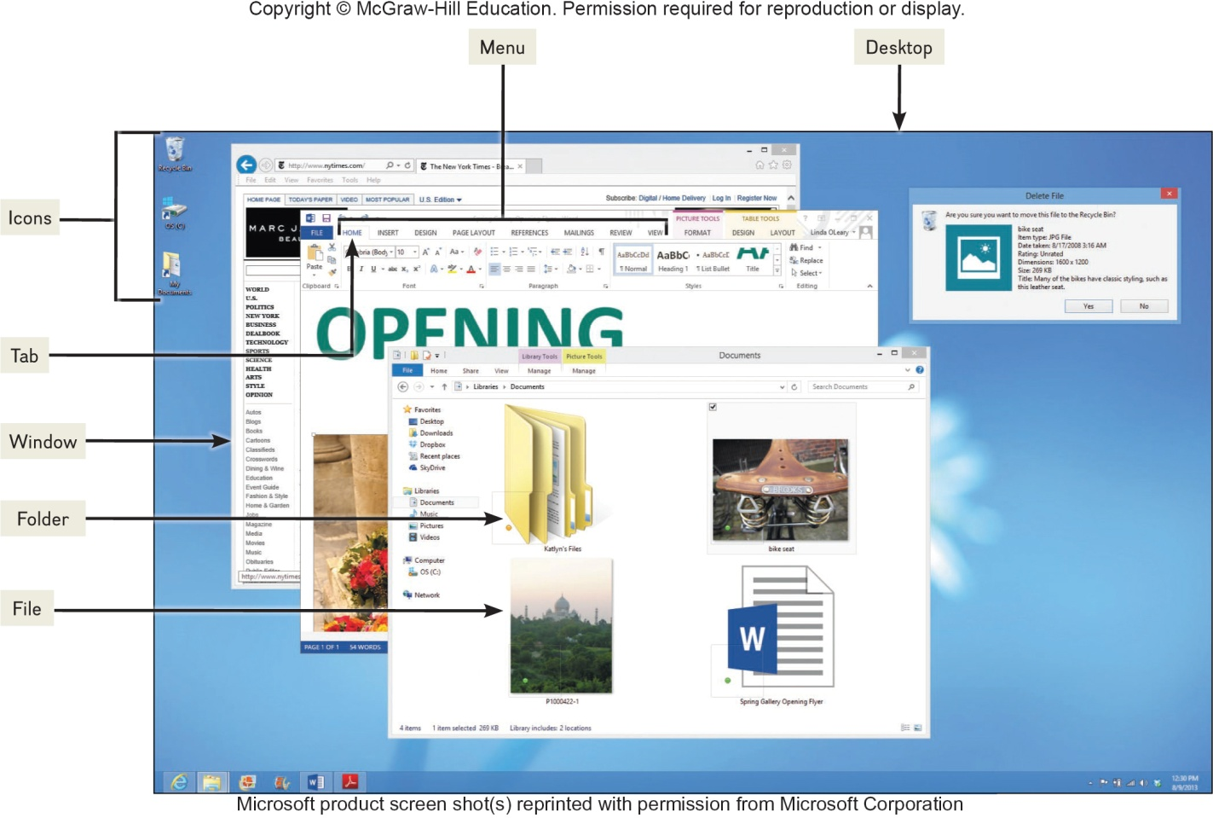
Features of an Operating System
System Software - Operating Systems
Booting – starting or restarting the computer
Features in common with application software
Icons
Pointer
Windows
Menus
Tabs
Dialog boxes
Help
Gesture Control
Files and Folders
Files share data and programs
Folders store related files
Notes:
Booting (key term) is the process of starting a computer
Warm boot (Key Term) – computer is already on and you restart it without turning off the power
Cold boot (Key Term) – starting a computer that has been turned off
Common features in application software:
Gesture Control (key term) is the ability to control operations with finger movements: i.e. swiping, sliding and pinching
Most operating systems store data and programs in system files (key term) and folders (key term)
Files and folders
Files share data and programs
Folders store related files

Slide 9
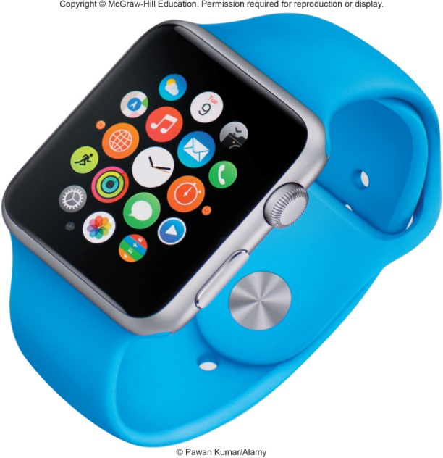
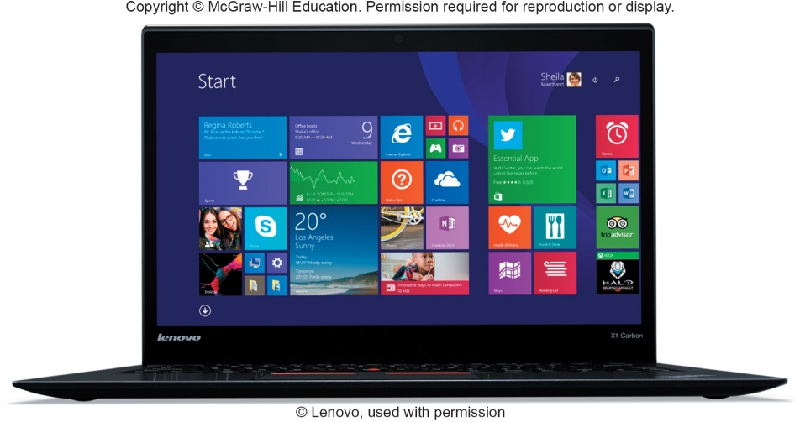
Categories of Operating Systems
System Software - Operating Systems
Three basic categories
Embedded operating systems – RTOS (real-time operating systems)
Smartphones
Smartwatches
Video game systems
Stand-alone operating systems
Also called desktop operating system
Network operating systems (linked computers)
Windows Server, Linux, Unix
OS stored on network server which coordinates all communication between the other computers
Notes:
Three basic categories of operating systems:
Embedded OS (key term) – used for handheld devices
RTOS – real-time operating system
Stand-alone (key term) – or desktop operating systems (key term) – control a single desktop computer
Network operating systems (NOS) (key term) – control and coordinate networked computers. OS is stored on the network server (key term)
Operating system is often referred to as the software environment (key term) or software platform (key term) almost all OS’ are designed to run only on specific platforms

Slide 10
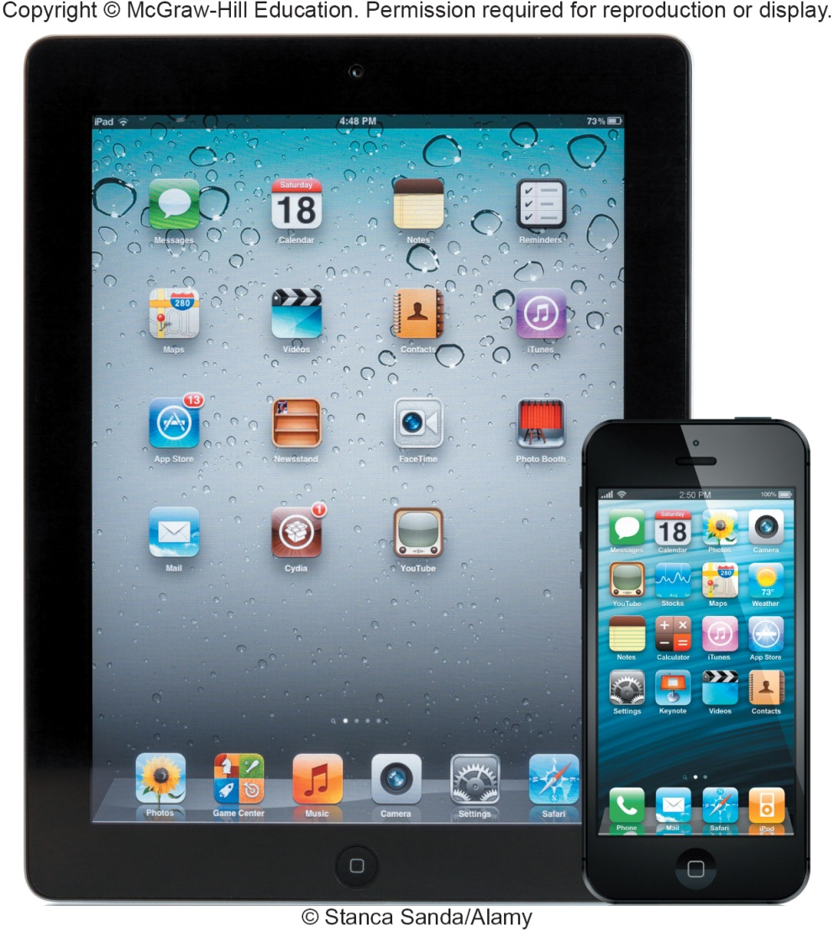
Mobile Operating Systems
System Software - Operating Systems
Mobile OS
Embedded operating system
Less complicated and more specialized for wireless
Some of the best known
Android
iOS
Windows Phone
Notes:
Mobile operating systems (key term) also known as mobile OS (key term) are embedded OS that are less complicated and more specialized for wireless technology
Android (Key term) – owned by Google
iOS (key term) - formerly iPhone OS (key term) , iPad and iPhone
Windows Phone (key term) – introduced by Microsoft to support a variety of devices including smartphones

Slide 11
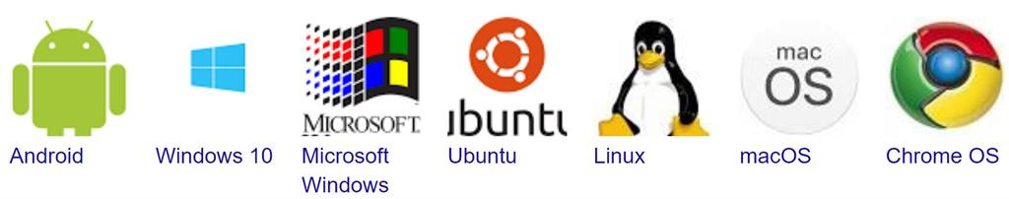
Desktop Operating Systems
System Software - Operating Systems
Operating systems commonly used by individuals
Windows – most widely used
Mac OS – powerful and easy to use
UNIX – network; originally designed for Web
LINUX – non proprietary; free from the Web

Slide 12
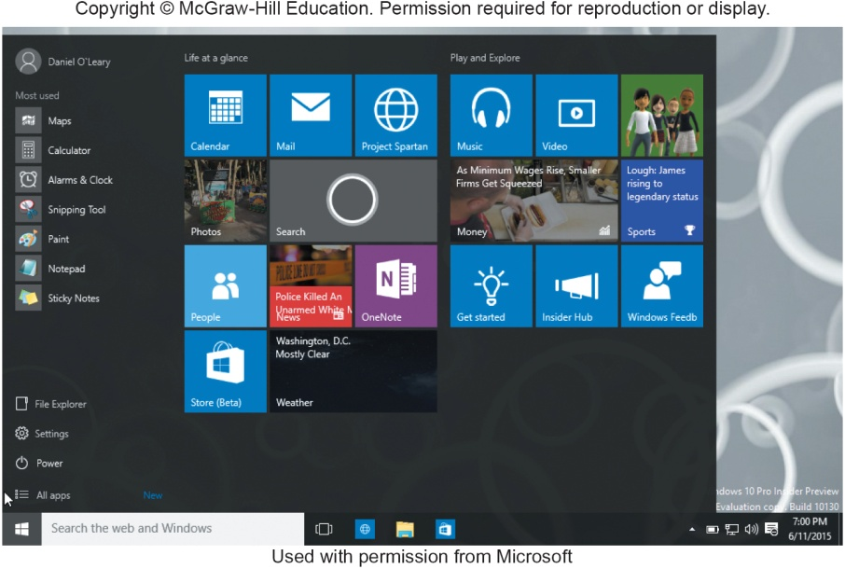
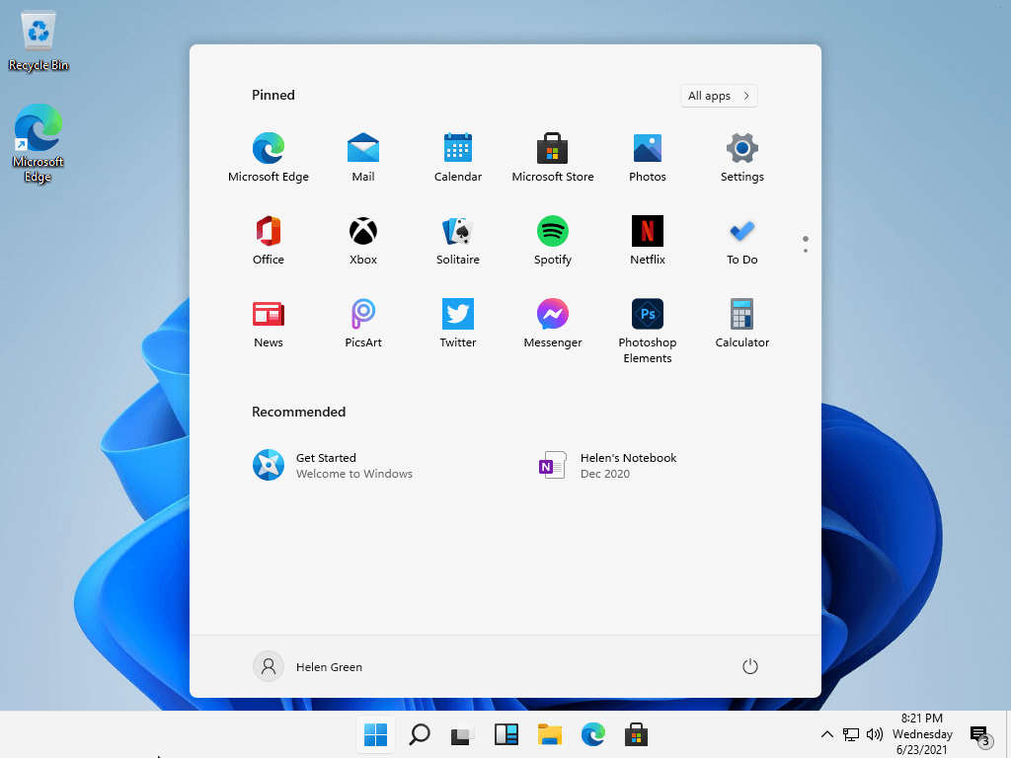
Windows - Most Used OS
System Software - Operating Systems
Windows 10
Windows 11
Merges Windows desktop and mobile operating systems
Adds haptics to the digital pen
Can input information not only by typing and clicking, but also through touching, writing, and speaking (voice)
Source:
https://www.minitool.com/news/windows-11-vs-windows-10.html
Notes:
Windows (key term) most widely used microcomputer
Windows 8 (key term) – integrated desktop and mobile. Released in 2012
Uses tiles (key term) to display active content linked to applications
Tiles can be accessed through the start screen (key term)
Can still get the traditional desktop, Windows RT (key term), to run on the tablet
More application programs are designed to run under Windows than any other operating system
Windows 10 (key term) runs on all Windows devices
Cortana (key term) is a digital assistant that accepts voice or text

Slide 13
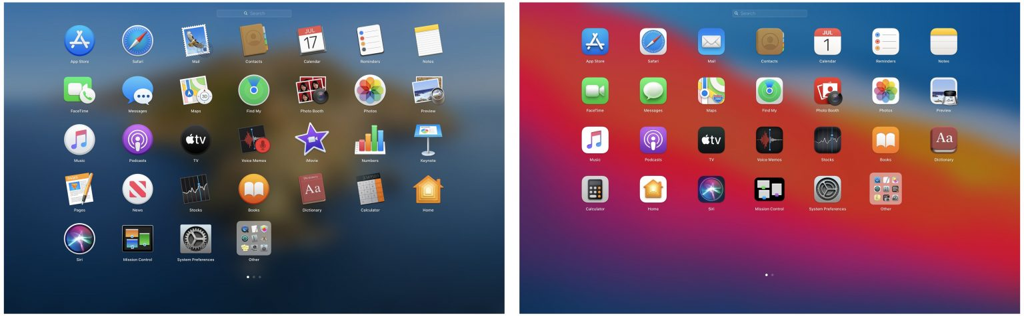
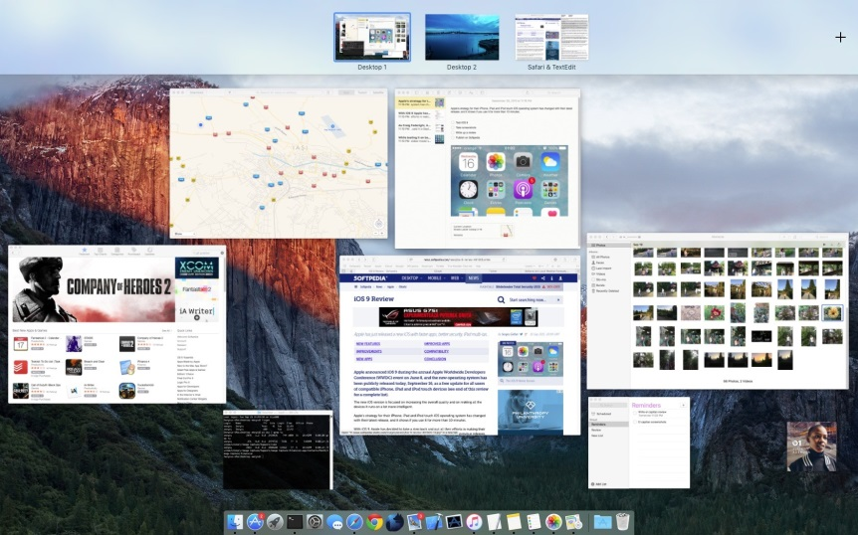
Mac OS
System Software - Operating Systems
Two most recent versions:
Big Sur
The most advanced desktop operating system
Catalina
Next generation OS
Mac OS X runs on Apple computers:
OS X El Capitan
Focused performance, stability, and security
OS X Yosemite
New user interface
OS X Mavericks
Improved power management
App icon in Launchpad on Mac OS Catalina (left) and Big Sur (right)
Source: https://www.idownloadblog.com/2020/07/07/macos-catalina-big-sur-visual-comparison/
The OS X El Capitan Desktop
Source: https://news.softpedia.com/news/os-x-10-11-el-capitan-review-493129.shtml
Notes:
Mac OS (key term) – not as widely used as Windows, designed to run on a MAC
Fewer programs written for it
Mac OS X (key term) – most widely used MAC OS; has two versions.
OS X Mavericks – released in 2012
OS X Yosemite – new user interface

Slide 14
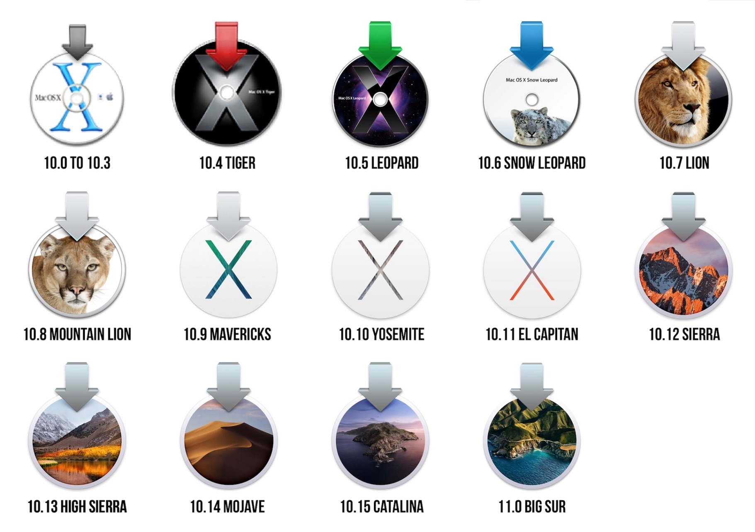
Mac OS
System Software - Operating Systems
The era of Mac OS X is over
Replaced with new Mac OS
Source:
https://arstechnica.com/gadgets/2020/11/macos-11-0-big-sur-the-ars-technica-review/
Notes:
Mac OS (key term) – not as widely used as Windows, designed to run on a MAC
Fewer programs written for it
Mac OS X (key term) – most widely used MAC OS; has two versions.
OS X Mavericks – released in 2012
OS X Yosemite – new user interface

Slide 15
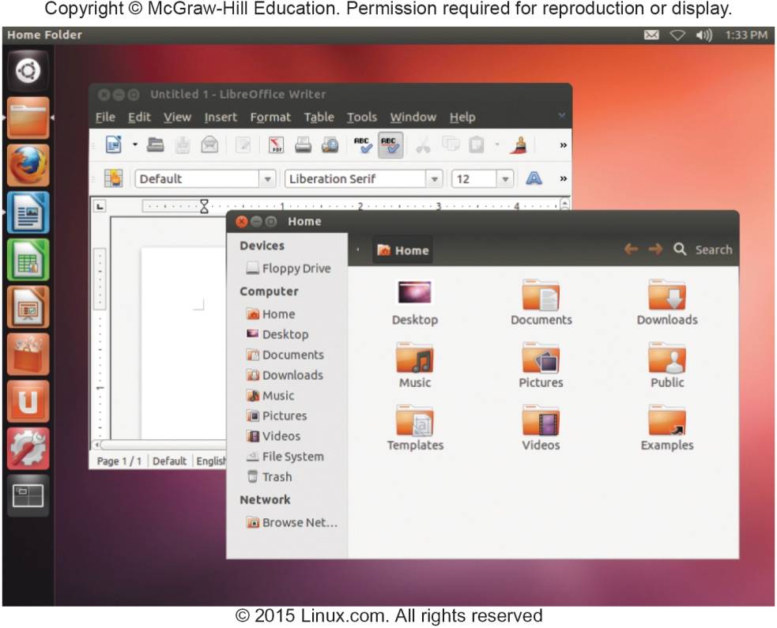
UNIX and LINUX
System Software - Operating Systems
UNIX operating system
Servers on the Web
Mainframe computers
Personal Computers
LINUX - version of UNIX
Alternative to windows
Open source - free
Google Chrome OS based on Linux
Focuses on Internet connectivity and cloud computing
Speed is determined by the speed of the Internet
Notes:
UNIX (key term) – originally designed to run on minicomputers but now is used in network environments
Used by powerful microcomputers and by servers on the Web
There are a large number of different versions of UNIX
LINUX – operating system that is an extension of UNIX versions
Free distribution of the operating system code – Open source (key term)
Google’s Chrome OS (key term) is based on Linux

Slide 16
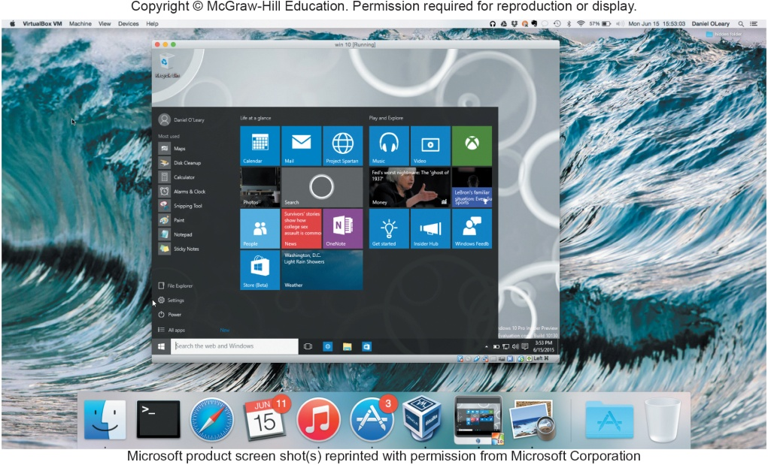
Virtualization
System Software - Operating Systems
Ability to support multiple operating systems on a single physical machine
Software virtualization
Each virtual machine appears as a separate independent computer
Host operating system
Guest operating system
Parallels
Mac to run Windows programs in Mac OS and Mac OS X
Notes:
Virtualization (key term) – supporting multiple OS that operate independently by running virtualization software (key term)
Each OS is known as a virtual machine (key term)
Host operating system (key term) - OS of the physical machine
Guest operating system (key term) - OS of virtual machine
Parallels (key term) is an example of a virtual software program that allows Mac to run Windows programs in OS X

Slide 17
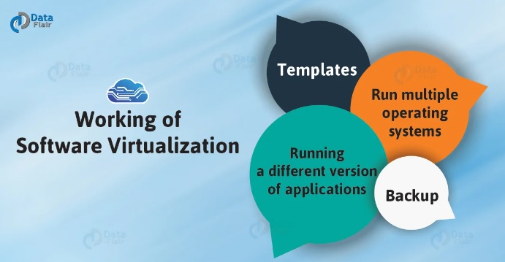
Types of Software Virtualization
System Software - Operating Systems
Operating System Virtualization
A hardware is used which consists of software on which different operating systems work
Application Virtualization
Refer to running an application on a thin client
Service Virtualization
A technique to simulate the behaviour of some components in a mixture of component-based applications
Source: https://data-flair.training/blogs/software-virtualization/
Notes:
Virtualization (key term) – supporting multiple OS that operate independently by running virtualization software (key term)
Each OS is known as a virtual machine (key term)
Host operating system (key term) - OS of the physical machine
Guest operating system (key term) - OS of virtual machine
Parallels (key term) is an example of a virtual software program that allows Mac to run Windows programs in OS X

Slide 18
System Software - Utilities
Specialized programs to make computing easier
Most essential utilities
Troubleshooting or diagnostic programs
Recognizes and correct problems
Antivirus programs
Guard your computer against viruses
Backup programs
Copies of files to restore if necessary
File compression programs
Reduces the size of files for more efficient storage
Notes:
Utilities (key term) – specialized programs designed to make computing easier
Troubleshooting program (key term) or diagnostic program (key term) recognize and correct problems
Antivirus program (key term) guard your computer against viruses
Backup program (key term) makes copies of files to restore if the originals are damaged
File compression program (key term) reduces the size of the file requiring less storage space

Slide 19
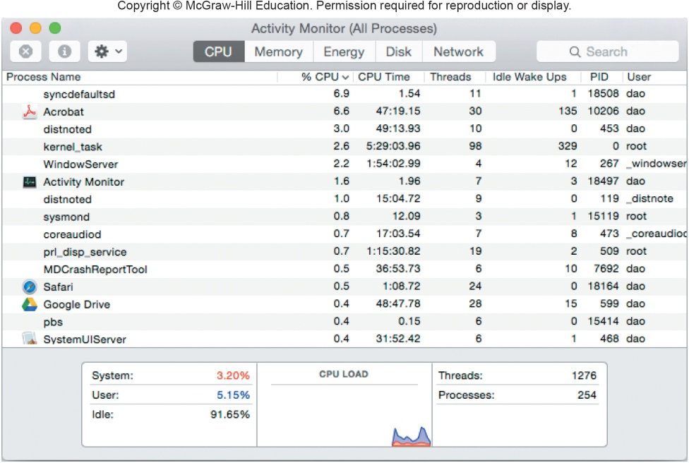
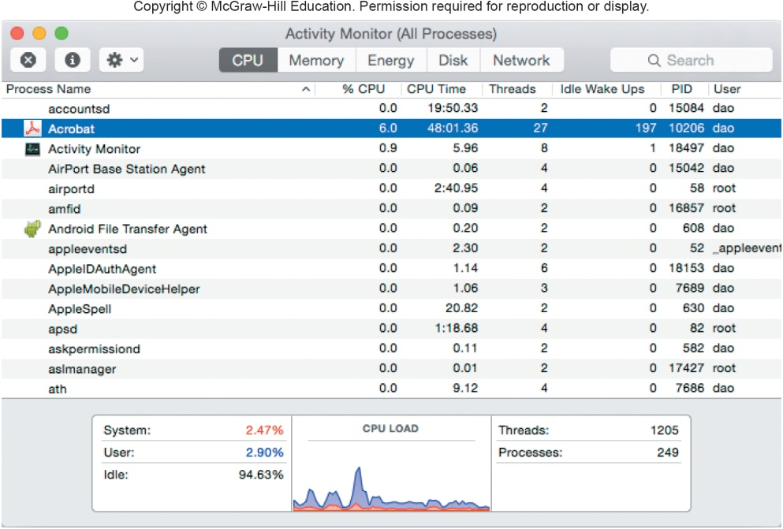
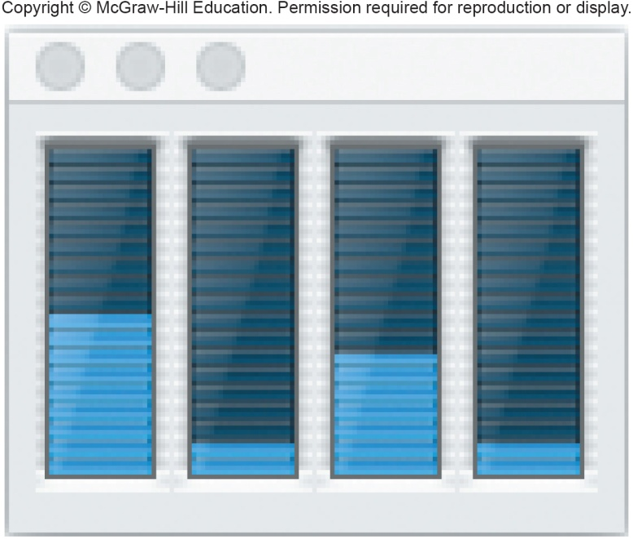
Making IT Work for You – Mac OS X Activity Monitor
System Software - Utilities
Has your computer ever just stopped responding? What do you do?
Mac OS X Activity Monitor is designed to help.
Notes:
Mac OS X Activity Monitor gives you a view of every program that is currently running in RAM.
Press and momentarily hold the space bar
Type Activity Monitor and press return

Slide 20
Windows Utilities
System Software - Utilities
Windows Operating Systems includes utilities such as:
File History
Can create a backup for your hard drive
Disk Cleanup
Identifies and eliminates non essential files
Disk Defragmenter
Rearranges files and unused disk space to optimize performance
Notes:
File History (key term) – can create a backup for your hard drive
Disk Cleanup (key term) identifies and eliminates non essential files
Disk Defragmenter (key term) rearranges files and unused disk space to optimize performance

Slide 21
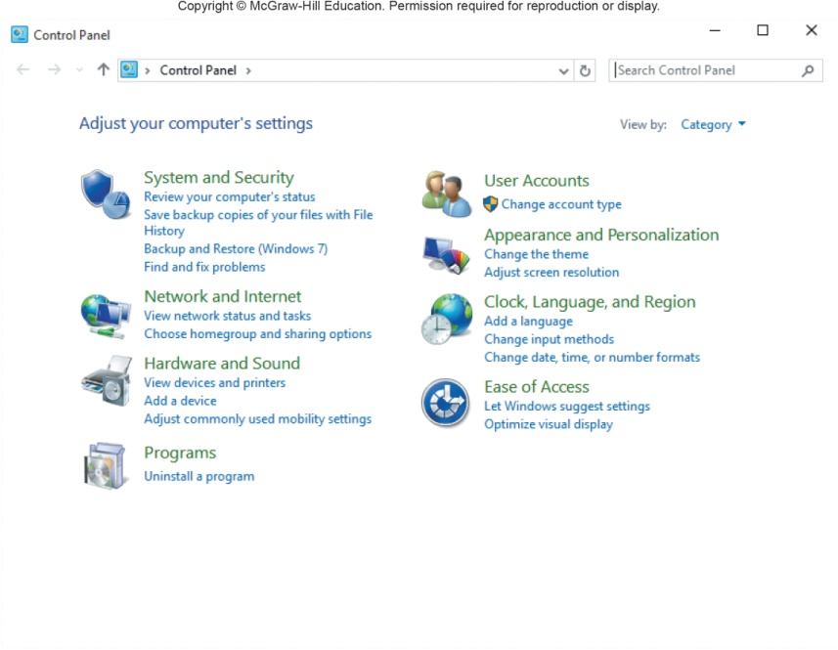
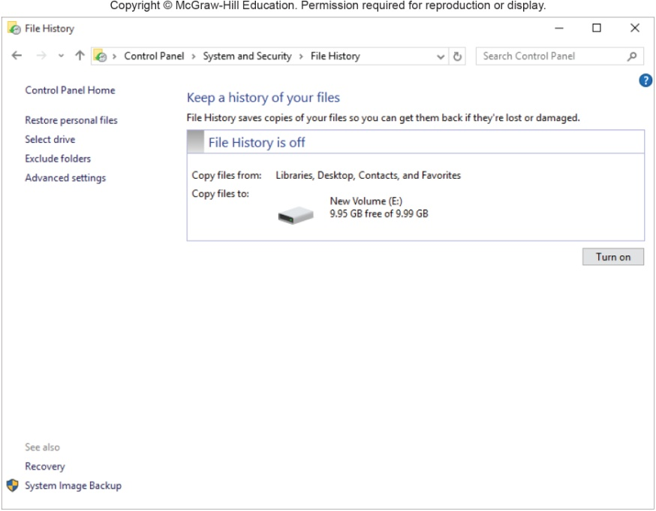
File History
System Software - Utilities
Utility program included with Windows 8
Makes a copy of all files in the libraries, contacts, favorites and the desktop
Helps prevent the effect of disk failure
Notes:
You can select File History from the Windows 8 System and Security window and create a backup for your hard disk.

Slide 22
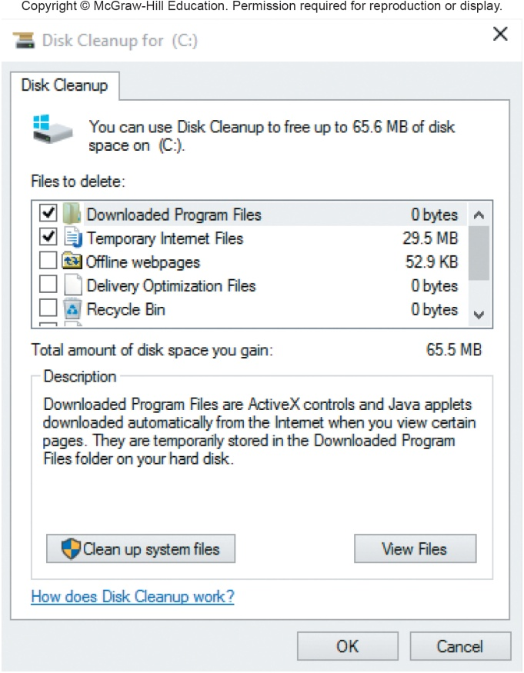
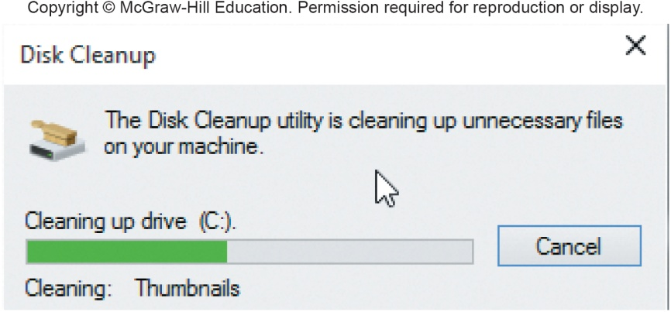
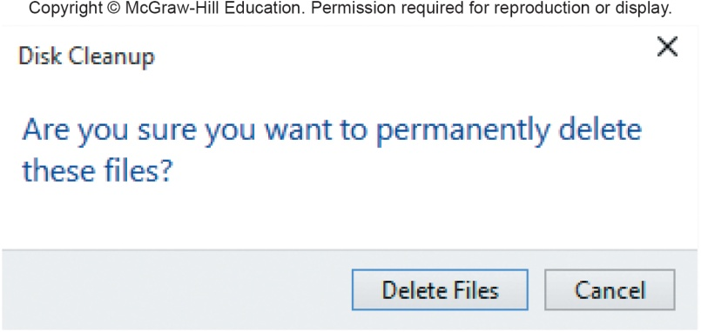
Disk Cleanup
System Software - Utilities
Identifies and eliminates nonessential files
Frees up valuable space and improves system performance
Notes:
When you search the Web, a variety of programs and files are saved to your hard drive
Use disk cleanup (Key Term) to get rid of these unnecessary files

Slide 23
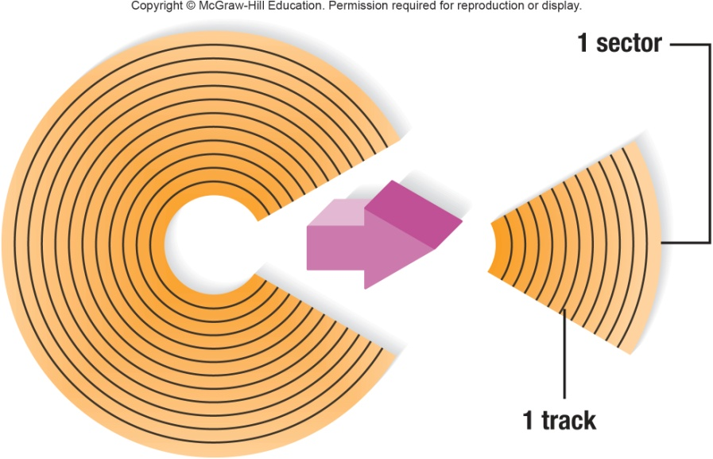
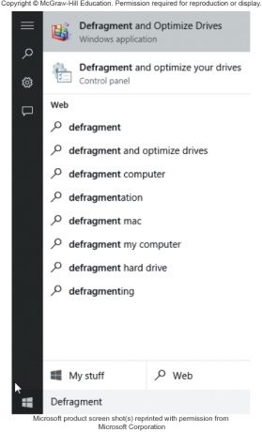
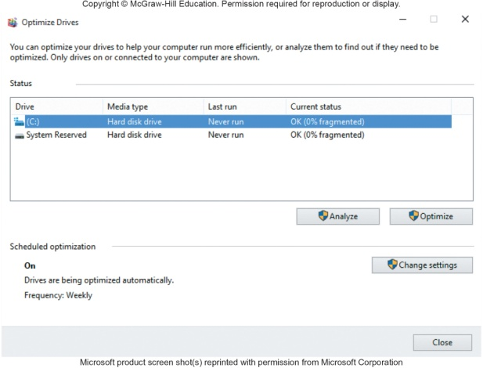
Disk Defragmenter
System Software - Utilities
Files are organized in tracks and sectors
Tracks – concentric ring
Sectors – wedge-shaped sections of a track
Optimize drives - utility program
Identifies and eliminates unnecessary fragments
Files become fragmented
Broken up and stored in non contiguous space
Rearranges files and unused disk space to optimize operations
Notes:
Files are stored and organized on a disk according to tracks and sectors
Tracks (Key Term) – concentric ring
Sectors (Key Term) – wedge-shaped sections of a track
OS tries to save a file on a single track across contiguous sectors. Often the file has to broken into small parts and stored wherever space is available and the disk over time becomes fragmented (key term)
Disk Defragmenter (Key Term) should be run on your computer often
Some end-users run this utility program daily, while some run it once a week
Fragmented (Key Term) files - result of a file having to be broken apart into smaller parts so it can be stored wherever space is available

Slide 24
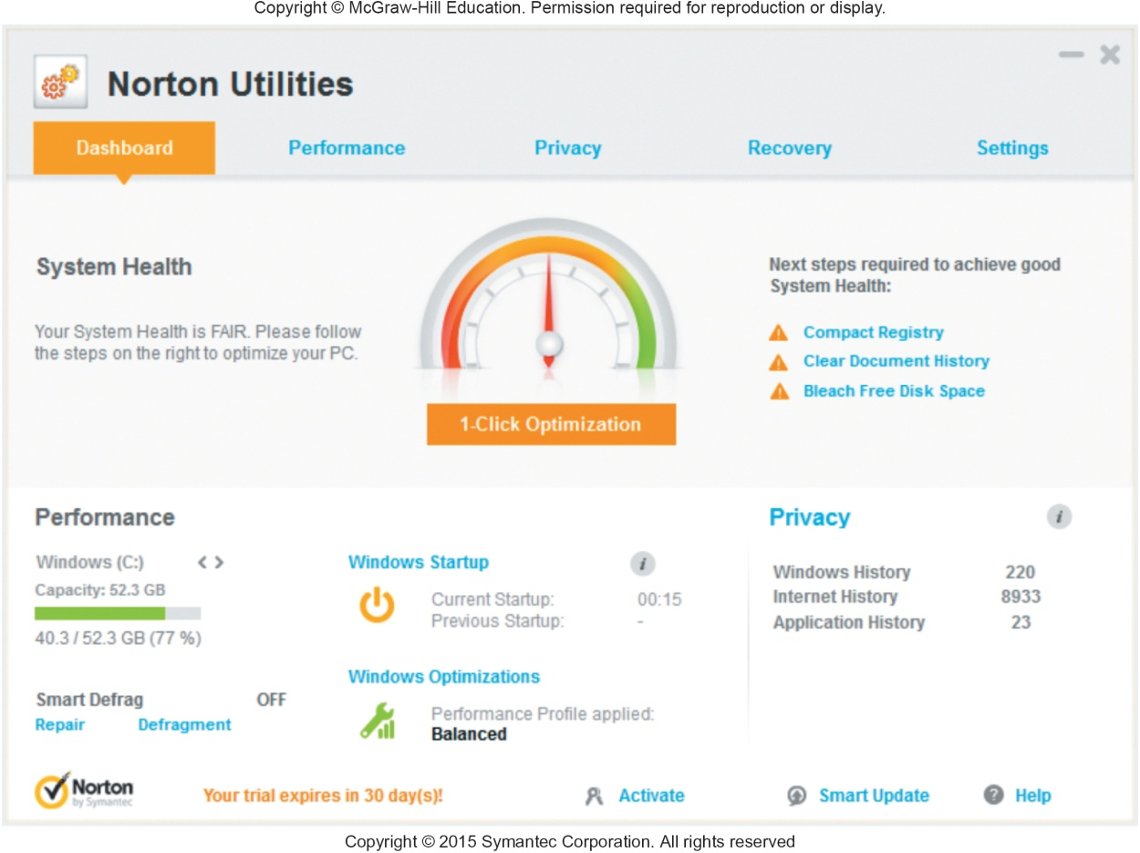
Utility Suites
System Software - Utilities
Combine several programs into one package
Less expensive
Popular suites
Bit Defender
Norton Utilities
Kaspersky
Notes:
Utility Suites (key term) combine several programs into one package
Suites provide a variety of utilities:
Programs to protect your system against viruses (key term)

Slide 25
Application software

Slide 26
Application software
Application software (App) is a software that performs specific functions for the end user by interacting directly with it.
The sole purpose of application software is to aid the user in doing specified tasks.
Example of Application Function:
Web browsers: Firefox and Google Chrome,
Personal computer or laptop: Microsoft Word, Excel, and many more
Smartphone apps: WhatsApp and Telegram,
Games apps: Candy Crush Saga and many more
Popular services that people rely on every day: weather or transportation information,
Apps that connect end users with their businesses.

Slide 27
Application software –
The need for application software
End-users can use application software to perform any type of single or many tasks. Following are a few reasons you would definitely need application software (App) on your computer:
Helps the user in completing specific tasks: Any application software should, in general, be created with the end user in mind. They will primarily benefit the end-user by assisting them in doing specialized activities in a range of industries, including education, business, and entertainment.
Manages and manipulates data: Application software is used in businesses to manage and alter employee, customer, and other databases.
Allows users to effectively organize information: Data can be created and handled efficiently by individual users using application software.

Slide 28
Application software –
The need for application software
Software for healthcare applications for seamless connectivity and quick response
Example:
Electronic Health Records (EHRs)
Electronic Prescription Systems (EPSs)
Telemedicine Software
Managing information and data in an organization
Example:
watsonx.data
IBM Db2
Zendesk
Managing and checking documents across
Example:
MasterControl
GLOBODOX
Zapier

Slide 29
Application software –
The need for application software
Software for educational purposes such as Learning Management Systems and e-learning systems
Example:
Docebo
Adobe Captivate
Google Classroom
Development of visuals and video for presentation purposes
Example:
PowerPoint
Powtoon
Visme
Emails, text messaging, audio and video conferencing involved in presentation
Example
Google Meet
Webex

Slide 30
Application software –
Types of Application Software
Word Processing Software
Word Processing refers to using a personal computer (PC) or laptop to create, edit, save and print documents, which can be performed only with specialised software known as a Word Processor.
Example: Microsoft Word
Spreadsheet Software
Spreadsheet software is a type of computer program that enables a user to perform numerical functions and explore numbers through an automated version of an accounting worksheet.
Example: Microsoft Excel.
Presentation Software
Presentation software, also commonly known as presentation graphics, is a particular category of application program used to construct sequences of words and a series of pictures that tell a story or help support a speech or public presentation of any information or a launch of new products or services.
Example: PowerPoint

Slide 31
Application software –
Types of Application Software
Multimedia Software
Multimedia software can be described as the combination of text, audio, images, animation, or video to produce a wide scope of interactive content for both professional and personal use.
Example: PowerDvD
Web Browsers
A web browser can take you all over the internet. It retrieves data from other parts of the web and shows it on your desktop or mobile device for viewing. The data is transmitted using the Hypertext Transfer Protocol, which describes how text, images, and video are shared on the World Wide Web.
Example: Google Chrome
Educational Software
Educational software refers to any computer software designed solely for educational reasons. It includes a wide range of software, including language learning software, classroom management software (CMS), and reference software for students and other professionals.
Example: Moodle

Slide 32
Application software –
Types of Application Software
Graphics Software
Graphics software can be reworked with bitmap and/or vector graphics and can be utilised to create label templates.
Example: Canva, Adobe Illustrator, Photoshop
Freeware
Freeware is typically marketed for profit but might be allocated specifically for a business or commercial purpose with the aim of expanding the market share of any newly launched premium product.
Examples: Adobe Reader, Free Studio, and Skype.
Shareware
Shareware is software supplied for free on a trial basis for the user to test or use the programme for a specific amount of days with the understanding that the user may need or want to pay for it later if they are satisfied with the product usage. Some software manufacturers provide a shareware edition of their product with an expiration date built in, such that after 30 days, the user or customer can no longer access the application for further use.
Example: WinZip

Slide 33
Application software –
Types of Application Software
Simulation Software
Simulation software authorises engineers to evaluate, optimise, and compare product designs with other similar software by modelling real-world events in a computer-generated environment.
Example: Simulink, Autodesk Inventor
Open Source
Open source software is a specific code designed to be publicly accessible so that anyone can see, modify, and distribute the code as they see, which fits the purpose. It is designed to be decentralised and coordinated, depending on peer assessment and community production.
Example: GIMP, Shotcut
Closed Source
Closed source software is where the source code is not freely accessible. It is developed and delivered to the customer as a fully compiled, executable set of files. The developer often provides aid to users after purchase and ensures that the software works as the creator foresaw.
Example: Microsoft Windows

Slide 34
Application software –
Advantages of Application Software
It meets every client’s particular requirements and needs. The client usually recognizes that they must utilize only one explicit program to finish the task because it is designed explicitly for one reason.
Businesses that are related to specific applications can restrict access and think about strategies to monitor their activities.
Standard updates from engineers for Licensed application programming can be obtained using general logic of health.

Slide 35
Application software –
Disadvantages of Application Software
Developing and evolving any application software to achieve specific goals can be quite pricey for developers but this can have a strong impact on their financial plan and income stream, particularly if an unreasonable high amount of time is spent on a product that is not normally worthy.
Application software that is widely used by many of us and then disseminated on the internet is inherently vulnerable to infection by a bug or other malicious initiatives.

Slide 36
Difference Between System Software and Application Software
System Software | Application Software
The main purpose of this software is to manage the resources available in the system. It serves as an effective forum for the execution of application software | Application software designed to achieve a certain set of tasks.
System software is documented in a low-level programming language like machine code or assembly language. | Application software is composed in a high-level language like Java, C++,.Net, or PHP.
Usually, when the computer is switched on, system software begins to run and stops when the computer is switched off. | When a user requests, application software runs according to the task it is assigned.
Without system software, a computer system cannot even activate. | User-specific application software is definitely not required to run the system.
The system software has a wide scope of capabilities. | The objective of the application software is to achieve or perform a certain task.
System software comprises language processors (interpreters, compilers, and assemblers), operating systems, and so on. | Payroll software, accounting software, MS Office, and so on are perfect examples of an application software.
Sources: https://www.geeksforgeeks.org/what-is-application-software/

Slide 37
Programming software

Slide 38
Programming software
Programming software is the software which helps the programmer develop other software.
It is a tool for creating computer code that allows computer software to operate.
Programming software includes compilers, assemblers, debuggers, interpreters, etc.

Slide 39
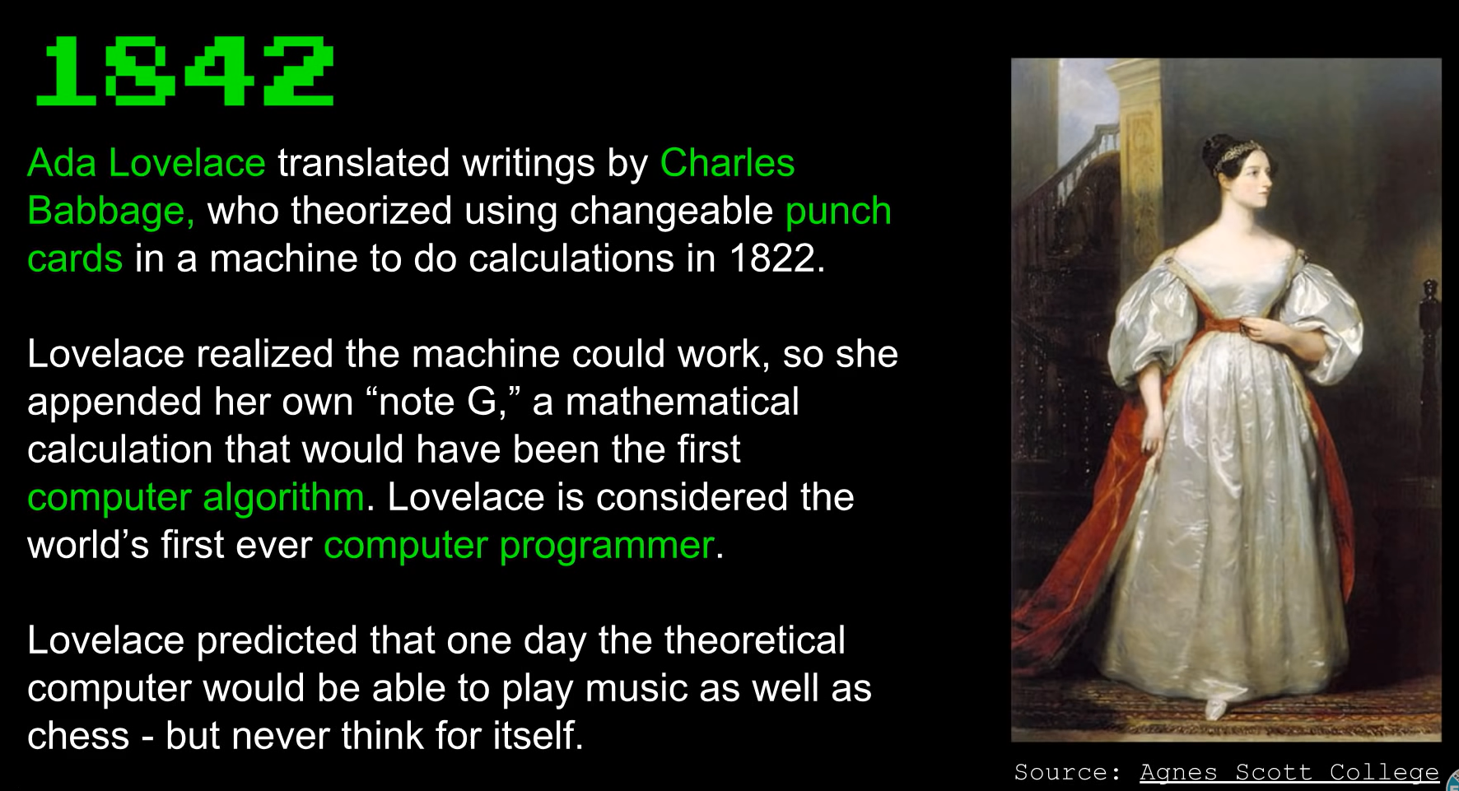
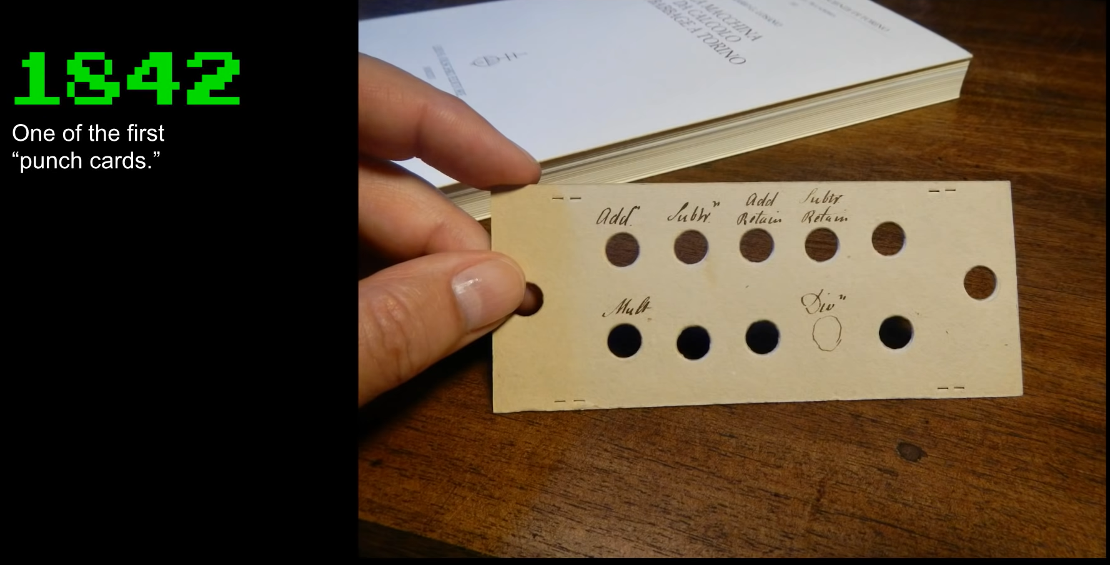
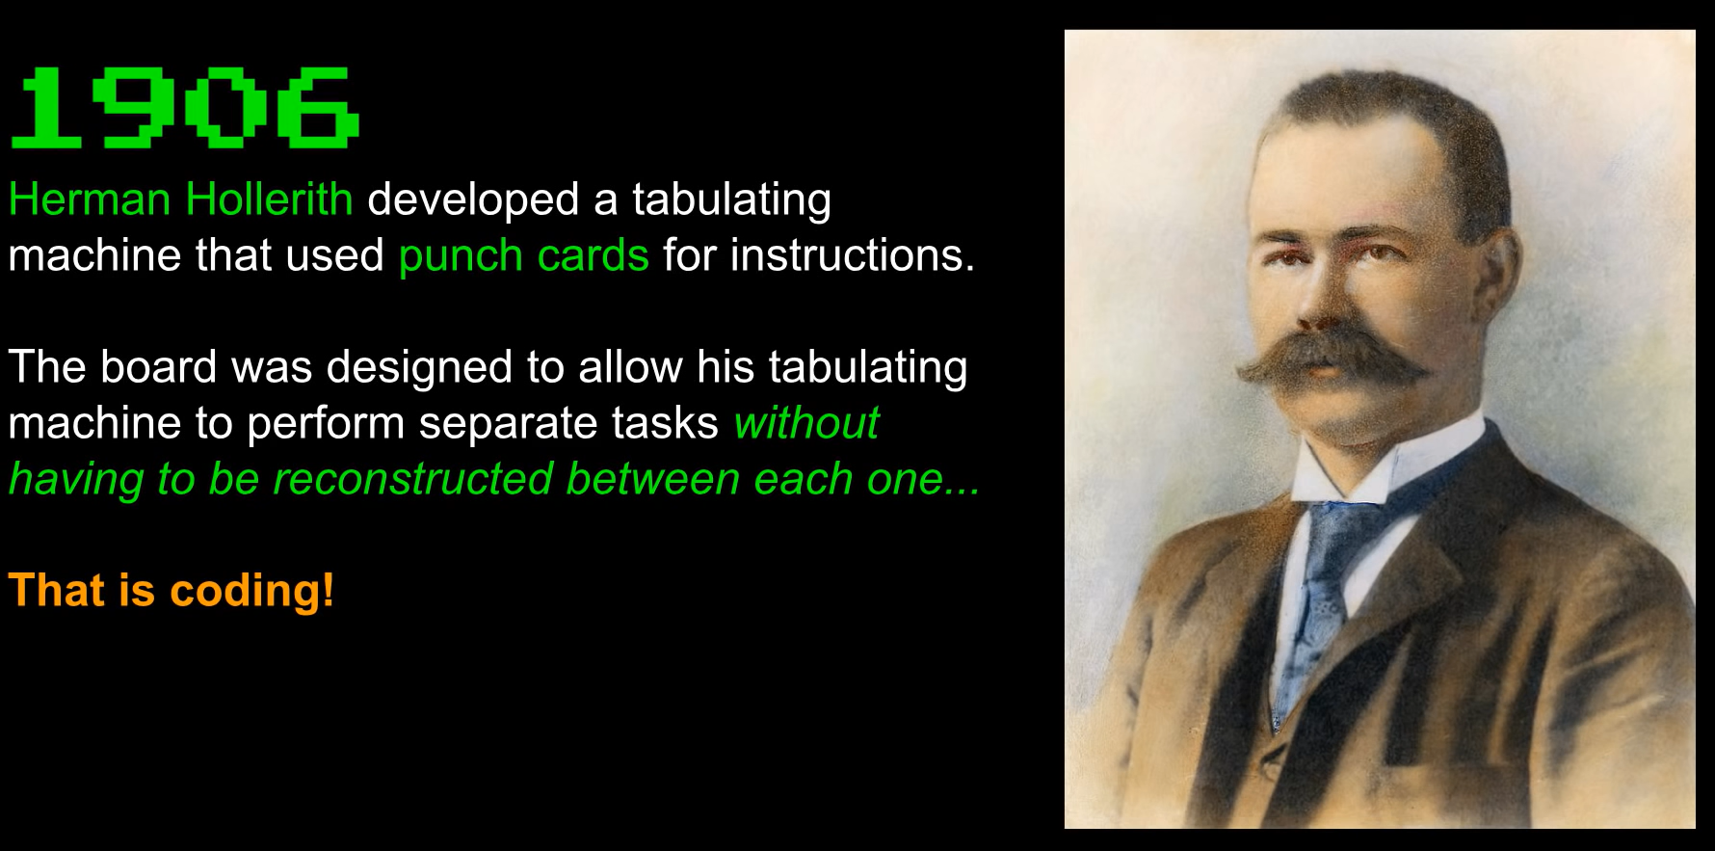
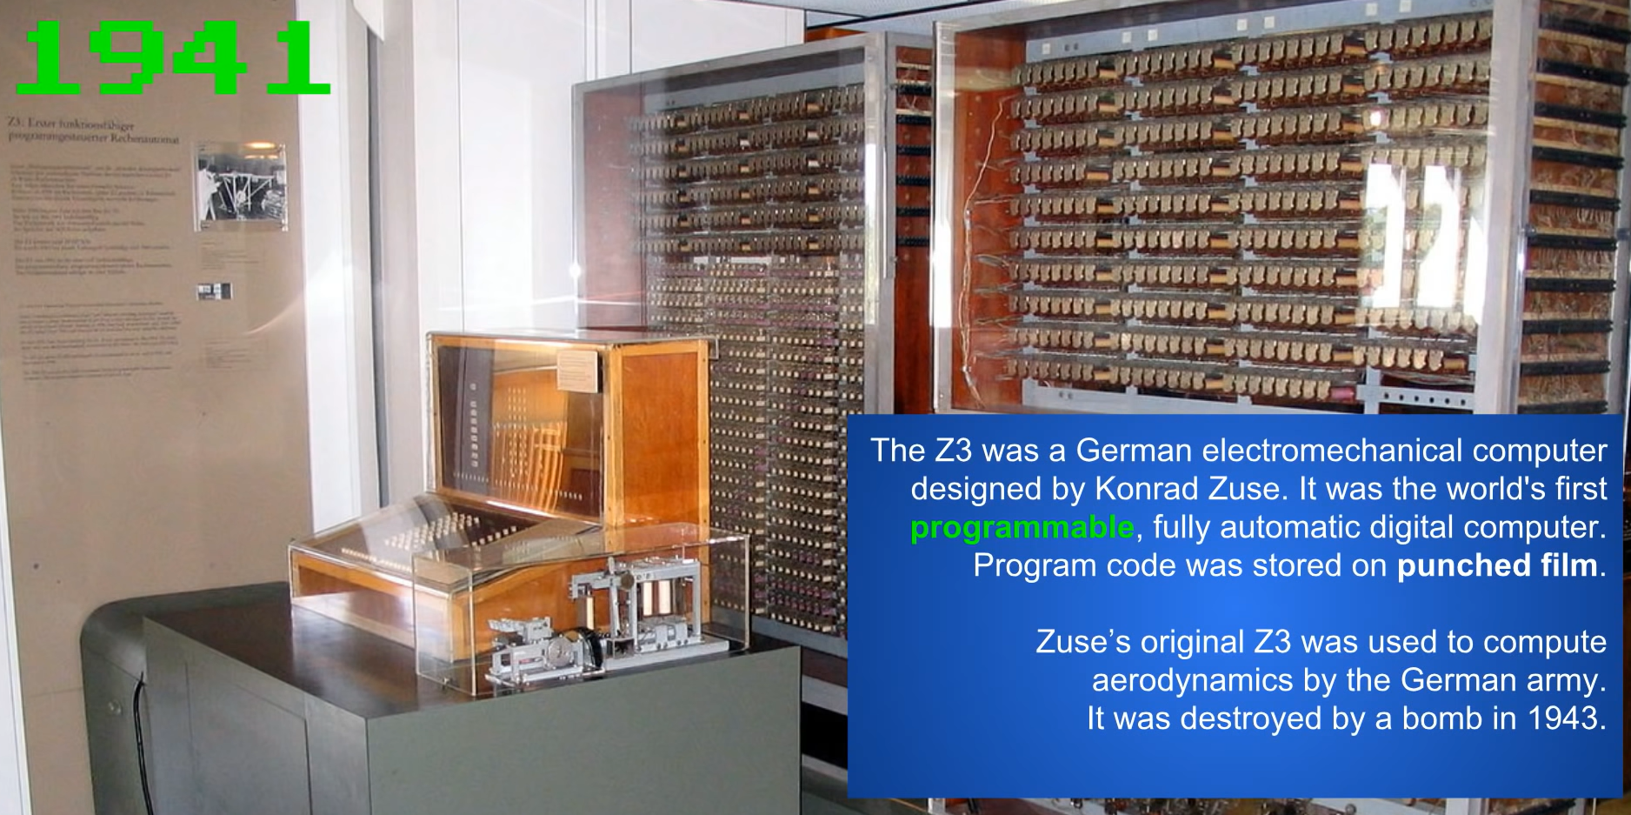
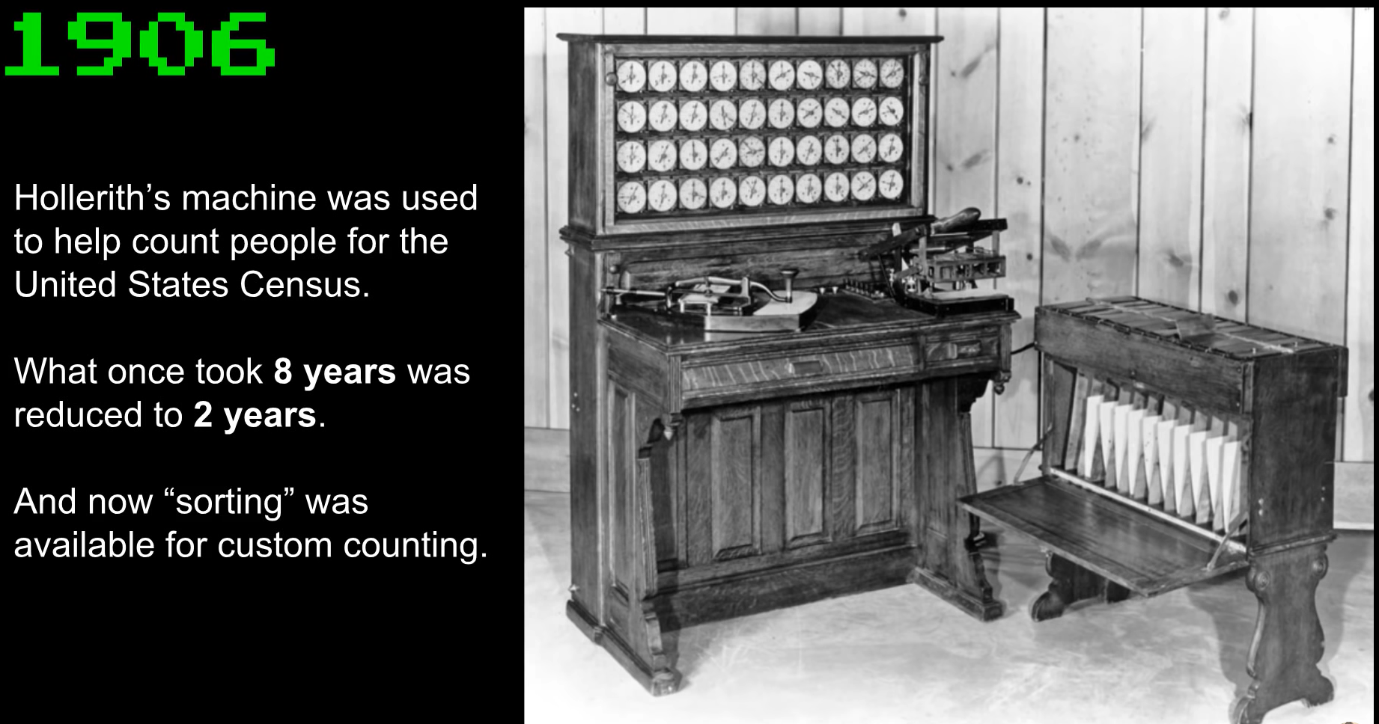
Programming software –
History of Programming software
Source: https://youtu.be/M4d3FXu9-3I?feature=shared

Slide 40
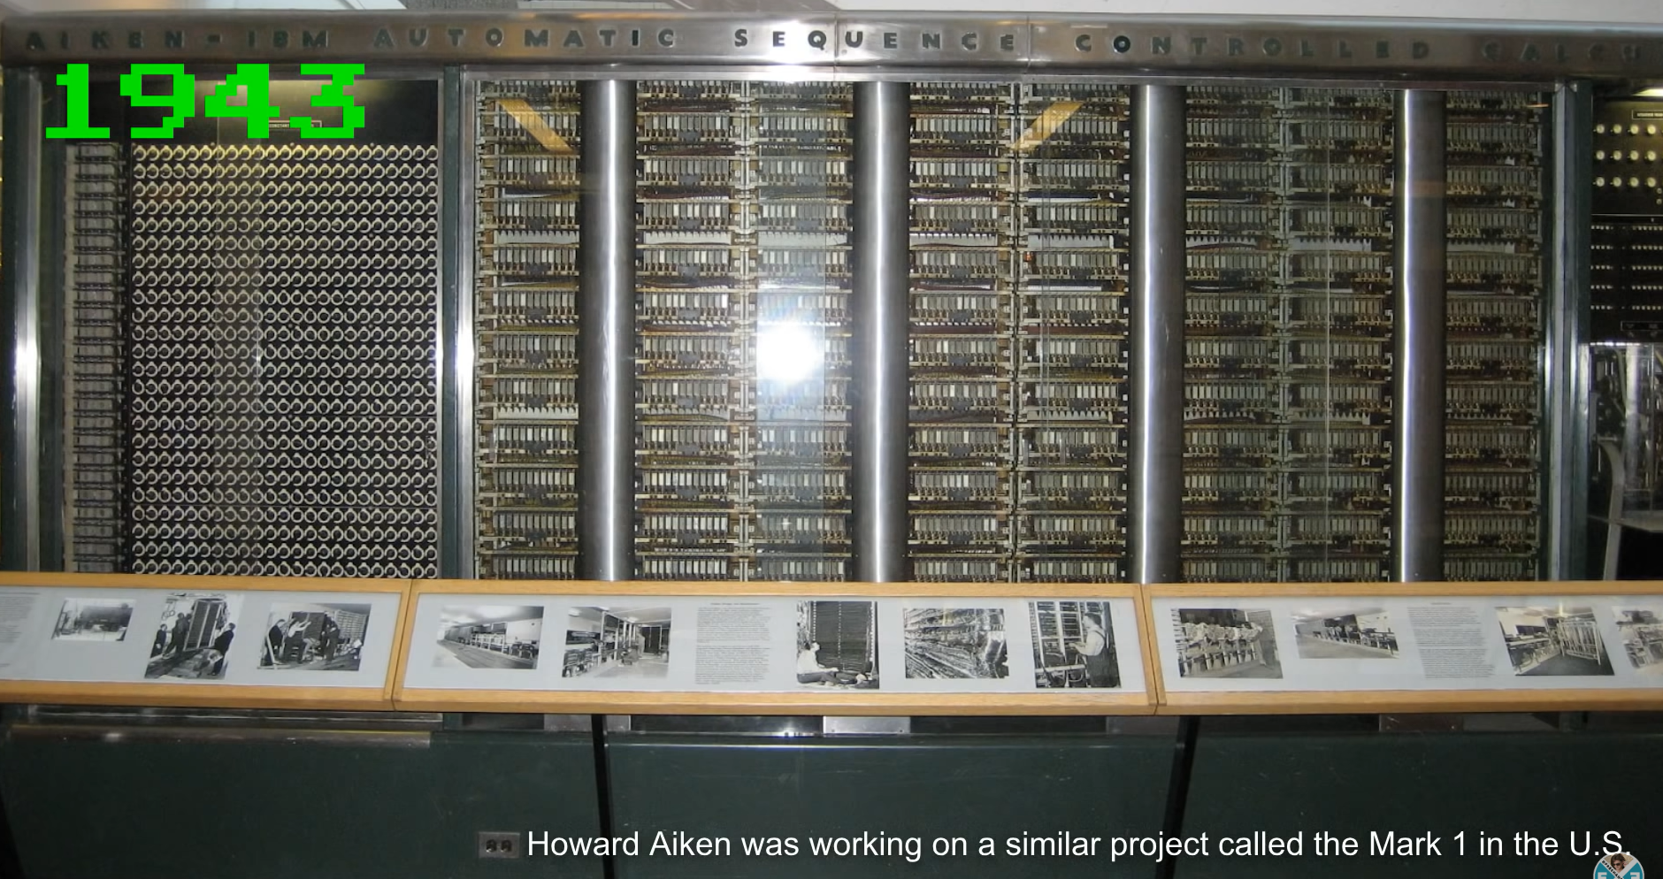
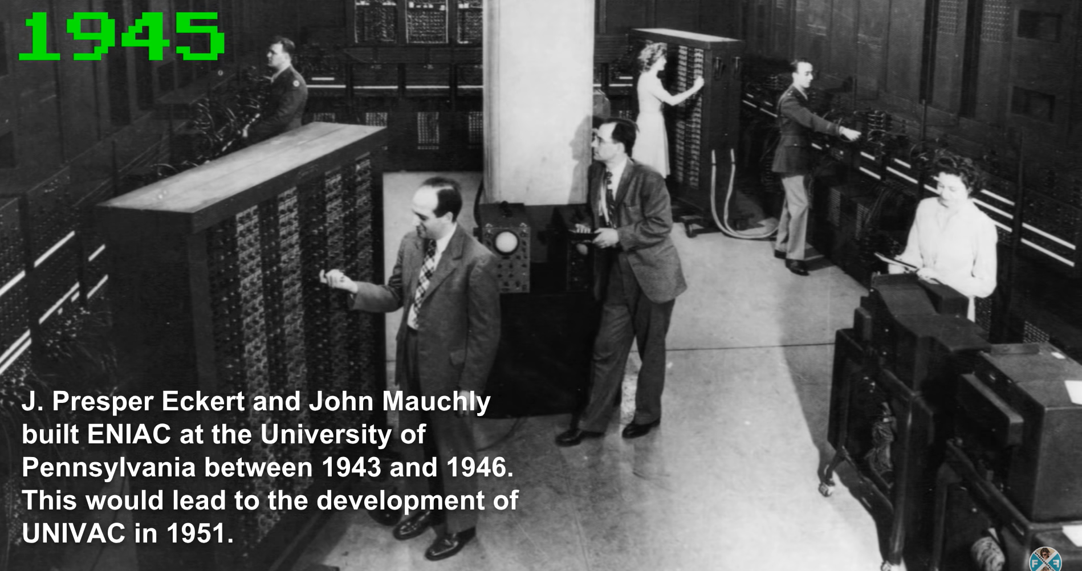
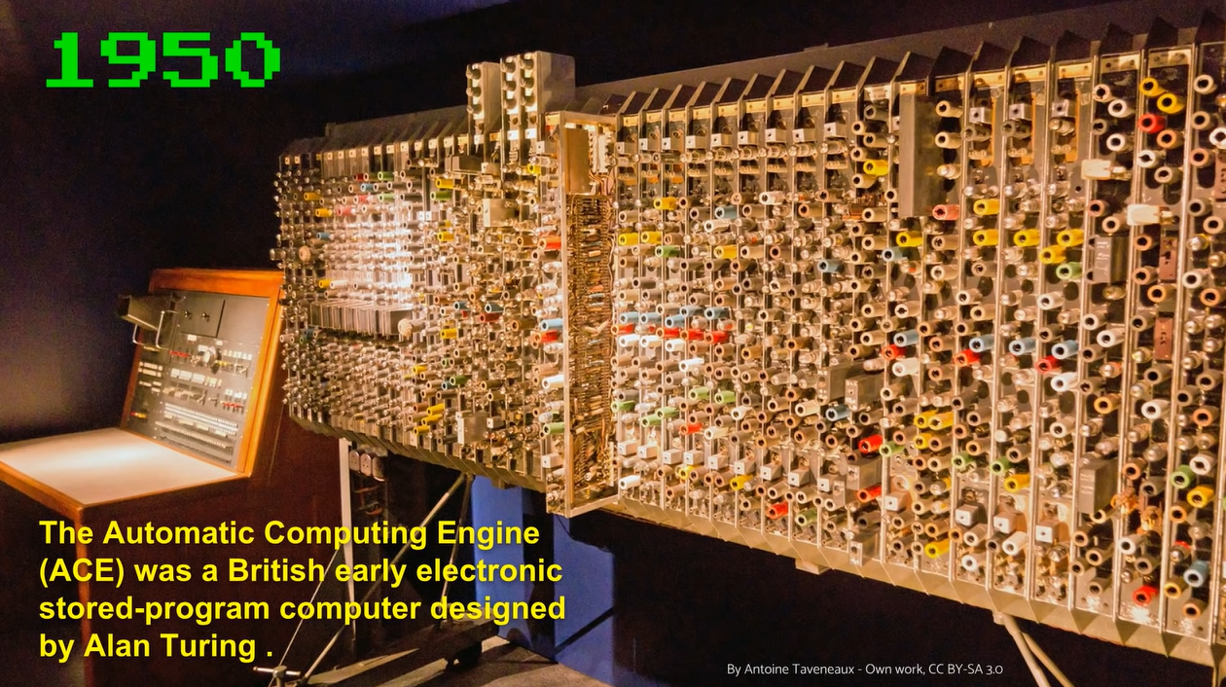
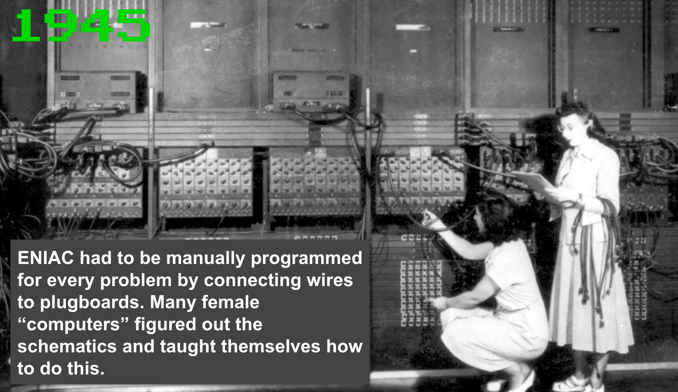
Programming software –
History of Programming software
Source: https://youtu.be/M4d3FXu9-3I?feature=shared

Slide 41
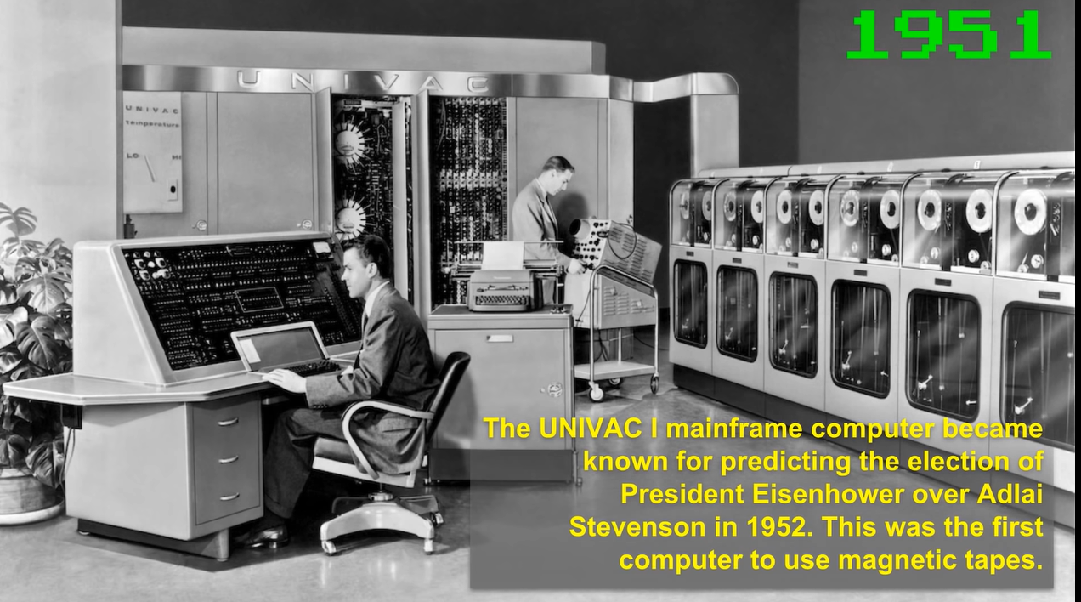
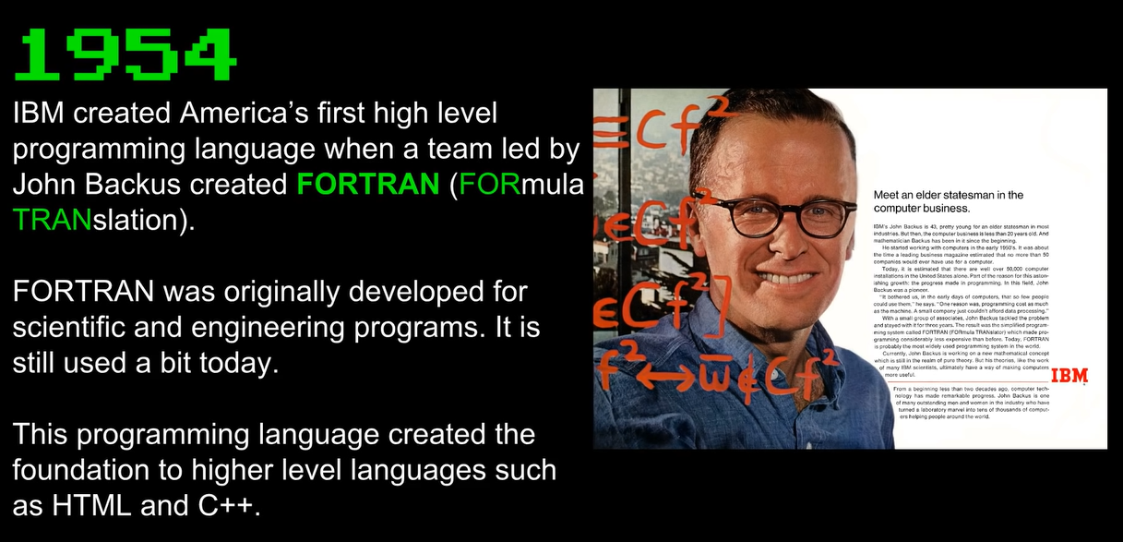
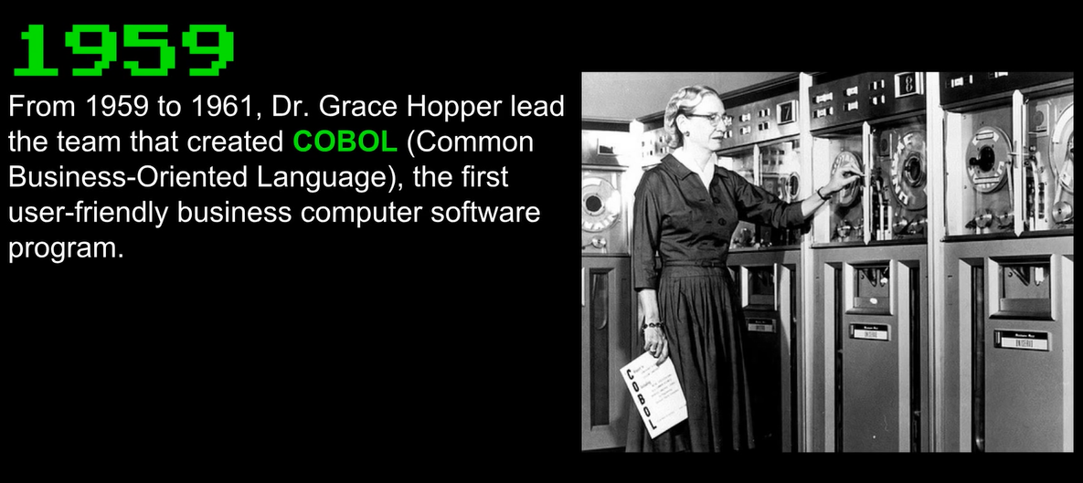
Programming software –
History of Programming software
Source: https://youtu.be/M4d3FXu9-3I?feature=shared

Slide 42
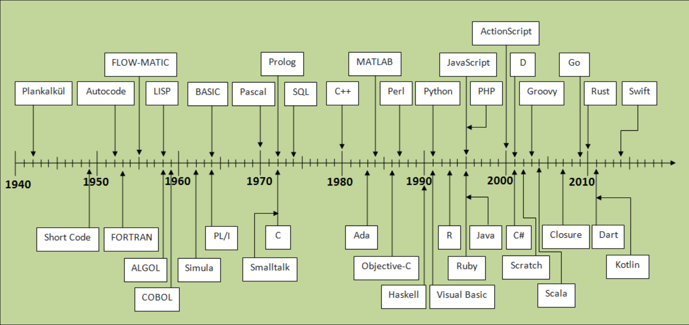
Programming software –
History of Programming software
Sources: https://javaconceptoftheday.com/history-of-programming-languages/

Slide 43
Programming software –
Type of programming software
All programming languages fall into two broad categories: high-level and low-level.
High-level Programming Software
High-level programming software is far from the code that translates commands on a computer system.
It is user-oriented because it has been designed to make it straightforward for a programmer to convert an algorithm into program code.
Examples: C#, Java, and Python.
Low-level Programming Software
Low-level programming software contains basic instructions for a computer to understand. It involves little-to-no abstraction from the core coding process.
Examples: assembly and machine code.

Slide 44
Programming software –
Component of programming software
Compilers
A compiler quickly reads the entire source program in the high-level language and translates it into an equivalent program in machine language.
assemblers,
The Assembler converts an Assembly language program into machine code. The source program is an assembler input that contains assembly language instructions. The assembler’s output is computer-readable object code or machine code.
debuggers,
As the name suggests, the debugger is a used for removing bugs from code. It simply allows other programs to be tested and debugged. Debugger may also provide two operation modes, complete and partial simulation. It is used to prevent software or systems from malfunctioning.

Slide 45
Programming software –
Component of programming software
interpreters
A language processor converts a single statement from the source program into machine code. An interpreter is a program that executes code immediately before moving on to the following line. If a statement contains an error, the interpreter stops translating at that point and displays an error message.
Integrated development environments (IDEs)
An integrated development environment (IDE) is a software application that helps programmers develop software code efficiently. It increases developer productivity by combining capabilities such as software editing, building, testing, and packaging in an easy-to-use application. Just as writers use text editors and accountants use spreadsheets, software developers use IDEs to make their job easier.

Slide 46

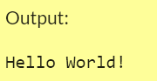
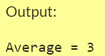
Programming software –
Example of programming software
#To run the Code online, use 🡪 https://onecompiler.com/
An imperative procedural language supporting structured programming, lexical variable scope, and recursion with a static type system. It was designed to be compiled to provide low-level memory access, and language constructs that map efficiently to machine instructions, all with minimal runtime support.
int main()
{ // Input array
int num[] = { 1, 2, 3, 4, 5 };
// Size of array
int n = sizeof(num) / sizeof(num[0]);
// average(num, n) function is return the average of the array.
int avg = average(num, n);
// Display average of given array
printf("Average = %d ", avg);
return 0;
}
Example 1: Hello World!
Example 2: Find the average
#include <stdio.h>
int main()
{
printf("Hello World!");
return 0;
}
#include <stdio.h>
// Function that return average of given array.
double average(int a[], int n)
{
// Find the sum of array element
int sum = 0;
for (int i = 0; i < n; i++)
sum += a[i];
return (double)sum / n;
}

Slide 47
Programming software –
Example of programming software
#To run the Code online, use 🡪 https://onecompiler.com/
An imperative procedural language supporting structured programming, lexical variable scope, and recursion with a static type system. It was designed to be compiled to provide low-level memory access, and language constructs that map efficiently to machine instructions, all with minimal runtime support.
int main()
{ // Input array
int num[] = { 1, 2, 3, 4, 5 };
// Size of array
int n = sizeof(num) / sizeof(num[0]);
// average(num, n) function is return the average of the array.
int avg = average(num, n);
// Display average of given array
printf("Average = %d ", avg);
return 0;
}
Example 1: Hello World!
Example 2: Find the average
#include <stdio.h>
int main()
{
printf("Hello World!");
return 0;
}
#include <stdio.h>
// Function that return average of given array.
double average(int a[], int n)
{
// Find the sum of array element
int sum = 0;
for (int i = 0; i < n; i++)
sum += a[i];
return (double)sum / n;
}

Slide 48
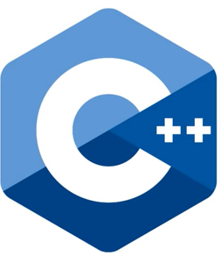
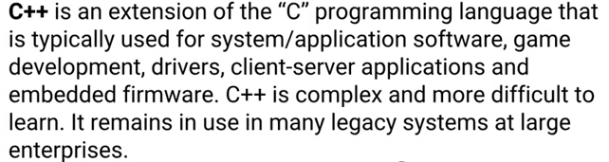
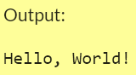
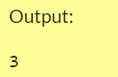
Programming software –
Example of programming software
#To run the Code online, use 🡪 https://onecompiler.com/
Example 1: Hello World!
Example 2: Find the average
#include <iostream>
using namespace std;
int main()
{
cout << "Hello World!";
return 0;
}
#include <iostream>
using namespace std;
// Function that return average of an array.
double average(int a[], int n)
{
// Find sum of array element
int sum = 0;
for (int i = 0; i < n; i++)
sum += a[i];
return (double)sum / n;
}
int main()
{
int num[] = { 1, 2, 3, 4, 5};
int n = sizeof(num) / sizeof(num[0]);
cout << average(num, n) << endl;
return 0;
}

Slide 49
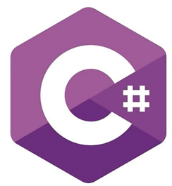
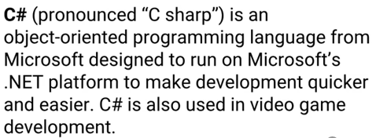
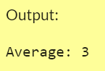
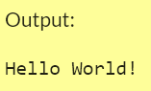
Programming software –
Example of programming software
#To run the Code online, use 🡪 https://onecompiler.com/
Example 2: Find the average
using System;
using System.Linq;
using System.Collections.Generic;
class Purata {
static void Main()
{
int[] numbers = { 1, 2, 3, 4, 5 };
int sum = 0;
for (int i = 0; i < numbers.Length; i++)
{
sum += numbers[i];
}
double average = (double)sum / numbers.Length;
Console.WriteLine("Average: " + average);
}
}
Example 1: Hello World!
using System;
namespace HelloWorld
{
class Program
{
static void Main(string[] args)
{
Console.WriteLine("Hello World!");
}
}
}

Slide 50


Programming software –
Example of programming software
#To run the Code online, use 🡪 https://onecompiler.com/
Example 1: Hello World!
print("Hello, World!")
Example 2: Find the average
numbers = [1, 2, 3, 4, 5]
average = sum(numbers)/len(numbers)
print("Average of list: ", average)

Slide 51



Programming software –
Example of programming software
#To run the Code online, use 🡪 https://onecompiler.com/
Example 2: Find the average
<?php
$numbers = [1, 2, 3, 4, 5];
$average = array_sum($numbers) / count($numbers);
echo $average;
?>
Example 1: Hello World!
<?php
echo "Hello World!";
?>

Slide 52



Programming software –
Example of programming software
#To run the Code online, use 🡪 https://onecompiler.com/
Example 1: Hello World!
<html>
<body>
<p>Hello World</p>
</body>
</html>

Slide 53
Malicious software

Slide 54
Malicious software
Malicious Software refers to any malicious program that causes harm to a computer system or network.
Malicious Malware Software attacks a computer or network through viruses, worms, trojans, spyware, adware, or rootkits.
These malicious programs steal, encrypt and delete sensitive data; alter or hijack core computing functions and monitor end users' computer activity.

Slide 55

Malicious software –
Different Types Of Malicious Software
Sources: https://www.techtarget.com/searchsecurity/definition/malware

Slide 56
Malicious software –
Different Types Of Malicious Software
Computer Malicious
A computer malicious is a software type that self-replicates and attaches itself to other files/programs. Malware Software can execute secretly when the host program/file is activated.
The different types of Computer malicious are Memory-Resident viruses, Program File Viruses, Boot Sector Viruses, Stealth viruses, Macro viruses, and Email Viruses.
2. Worms
A worm is a malicious software type similar to that of a computer malicious is a self-replicating program. However, in the case of worms, malicious automatically executes itself.
Worms spread over a network and can launch a cumbersome and destructive attack within a short period.

Slide 57
Malicious software –
Different Types Of Malicious Software
Trojan Horses
Unlike a computer malicious or a worm – the trojan horse is a malicious software non-replicating program that appears legitimate.
After gaining the trust, it secretly performs malicious and illicit activities when executed.
Hackers use trojan horses to steal a user’s password information and destroy data or programs on the hard disk. It is hard to detect!
Spyware/Adware
Spyware is malicious software that secretly records user information and forwards it to third parties.
The information gathered may cover files accessed on the computer, a user’s online activities, or even the user’s keystrokes.
Adware is a malware software type as the name interprets displays advertising banners while a program is running. Adware can also work like spyware, it is deployed to gather confidential information. Basically, to spy on and gather information from a victim’s computer.

Slide 58
Malicious software –
Different Types Of Malicious Software
Rootkit
A rootkit is a malicious software type that alters the regular functionality of an OS on a computer in a stealthy manner.
The altering helps the hacker to take full control of the system and the hacker acts as the system administrator on the victim’s system.
Almost all the rootkits are designed to hide their existence.

Slide 59
Malicious software –
How malware spreads?
Malware can get onto your computer in a number of different ways. Here are some common examples:
Downloading free software from the Internet that secretly contains malware
Downloading legitimate software that's secretly bundled with malware
Visiting a website that's infected with malware
Clicking a fake error message or pop-up window that starts a malware download
Opening an email attachment that contains malware
There are many different ways that malware can spread, but that doesn't mean you're powerless to stop it.
Sources: Google Ads Help

Slide 60
Malicious software –
Methods Of Protection Against Malicious Software
Keep your computer and software updated
Use a non-administrator account whenever possible
Think twice before clicking links or downloading anything
Be careful about opening email attachments or images
Don't trust pop-up windows that ask you to download software
Limit your file-sharing
Use antivirus software
Sources: Google Ads Help

Slide 61

A Look to the Future – Self Healing Computers
Self Healing Computers
Could mean an end to computer crashes and performance problems
Fix software problems
Reroute functions around broken hardware
IBM’s Automatic Computing Initiative (ACI)
Handles time-consuming maintenance
Self-regulating and virtually invisible
Self-maintaining servers
Self-repairing
Self-updating
Self-protecting

Slide 62
Trends in Software
User Experience Design
User Experience Design (UXD or UED) is the process of enhancing user satisfaction of a software product by improving the usability, accessibility, and pleasure provided across each touch point.
DevSecOps
DevSecOps (development, security, and operations) is an approach to software development (and culture) that embeds security throughout every stage of the DevOps pipeline.
Source: https://www.netsolutions.com/insights/the-future-of-software-development/

Slide 63

Trends in Software
Do You Apply DevSecOps?
Source: https://www.netsolutions.com/insights/the-future-of-software-development/

Slide 64
Trends in Software
Omnichannel Experiences
Omnichannel experiences offer a seamless experience to the customer or user across various channels: retail, telephone, online, mobile, or social.
The API Economy
The API economy is the use of APIs to achieve integration across services and data, allowing organizations to gain access to new services and products without building it themselves.
Balanced Development Automation
Research from GitHub has demonstrated that automating software delivery alone can lead to a 31% faster merge and helps teams decrease time-to-market.
Source: https://www.netsolutions.com/insights/the-future-of-software-development/

Slide 65
Trends in Software
Vulnerability Disclosure Programs
A vulnerability disclosure program (VDP) creates a secure channel for security issues and vulnerabilities to be reported following ISO standards around disclosure and handling and best practices around protecting whistleblowers.
Mobile First
Mobile traffic now makes up 54.8% of all web traffic, so it’s no longer about tagging a mobile website onto an existing design. Today, the approach needs to be mobile-first.
Source: https://www.netsolutions.com/insights/the-future-of-software-development/

Slide 66

Trends in Software
Mobile First Approach
Source: https://www.netsolutions.com/insights/the-future-of-software-development/

Slide 67
Trends in Software
Continuous Integration and Delivery
Continuous Integration, Continuous Delivery (CI/CD) is a way to introduce automation into the Agile and DevOps development process, a loop that implies constant updates to software to help improve quality and efficiency in the development process.
Serverless Computing
Serverless computing leverages managed cloud infrastructure (AWS, Azure, Google App Engine) to build apps without having to host or maintain the servers.
Source: https://www.netsolutions.com/insights/the-future-of-software-development/

Slide 68

Trends in Software
CI/CD Development Process
Source: https://www.netsolutions.com/insights/the-future-of-software-development/

Slide 69
Trends in Software
Blockchain
Blockchain, the use of a decentralized network of computers for digital transactions, is one of rapidly growing software development trends. In healthcare, blockchain could be one of the tools to help identify inaccuracies in patient data, reduce breaches, and help support patient access to health records.
Expansion of the IoT
The Internet of Things (IoT) is expected to have a CAGR of 10.53% within the next 5 years, creating new platforms of “things” that can run software, but also changing how data is tracked and collected, how users engage across IoT devices (omnichannel expectations), and even impacting inventory management or shipping. All of this data must be translated into insight, with IoT spurring the need for AI and analytics.
Source: https://www.netsolutions.com/insights/the-future-of-software-development/

Slide 70
Trends in Software
Escalation of the Edge Computing
Edge computing, the concept of a distributed IT architecture, places service provisioning, data, and intelligence closer to devices and users to help boost performance.
Quantum Computing
Quantum computing leverages quantum mechanics (superposition, interference, entanglement) to perform calculations, with the number of organizations and governments investing in quantum computing starting to improve processes and operations.
Source: https://www.netsolutions.com/insights/the-future-of-software-development/

Slide 71
Trends in Software
Big Data
Big data is a field that works with large or complex data sets of structured and unstructured data using advanced techniques. Look toward concepts such as the data fabric (the flexible integration of data sources), understanding the options of the data marketplace, analytics, edge infrastructure, and AI.
Augmented Reality (AR)
Virtual Reality (VR) and Augmented Reality (AR) continue to find new avenues for growth, through gaming applications but also other use cases including eCommerce, healthcare, manufacturing, and education. Apple is also rumoured to be releasing an AR/VR headset in 2022.
Source: https://www.netsolutions.com/insights/the-future-of-software-development/

Slide 72
Trends in Software
Low-Code / No-Code Platforms
Low-code development platforms (LCDP) and no-code development platforms (NCDP) offer pre-built blocks that can be dragged and dropped (visual environment) to assist in rapid development of mobile and web apps both by professional developers (for speed) and by those outside the IT department.
Source: https://www.netsolutions.com/insights/the-future-of-software-development/

Slide 73
Trends in Software
Artificial Intelligence (AI)
AI is the basis for mimicking human intelligence processes by creating and applying algorithms built into a dynamic computing environment.
AI is trying to make computers think and act like humans.
Achieving this end requires three key components:
Computational systems
Data and data management
Advanced AI algorithms (code)
The more humanlike the desired outcome, the more data and processing power required
Source: https://www.netapp.com/artificial-intelligence/what-is-artificial-intelligence/

Slide 74
Trends in Software
Machine Learning: An approach to AI in which a computer algorithm (a set of rules and procedures) is developed to analyse and make predictions from data fed into the system.
Machine learning-based technologies are routinely used every day, such as personalised news feeds and traffic prediction maps.
Neural Networks: A machine learning approach modelled after the brain in which algorithms process signals via interconnected nodes called artificial neurons.
Artificial neural networks have been used successfully to mimic biological nervous systems to recognise and predict patterns of neural signals involved in brain function.
Deep Learning: A form of machine learning that uses many layers of computation to form what is described as a deep neural network, capable of learning from large amounts of complex, unstructured data.
Deep neural networks are responsible for voice-controlled virtual assistants and self-driving vehicles, which learn to recognise traffic signs.

Slide 75

Trends in Software
Machine Learning Tops AI Funding Worldwide
Source: https://www.netsolutions.com/insights/the-future-of-software-development/

Slide 76

Trends in Software
Top Machine Learning Use Cases
Source: https://www.netsolutions.com/insights/the-future-of-software-development/

Slide 77
Trends in Software
EXAMPLE OF AI
ChatGPT
is a natural language processing tool driven by AI technology that allows you to have human-like conversations and much more with the chatbot.
The language model can answer questions and assist you with tasks, such as composing emails, essays, and code.
How to start using ChatGPT
https://www.youtube.com/watch?v=jHv63Uvk5VA

Slide 78
Open-Ended Questions (Page 1 of 2)
Describe system software. Discuss each of the four types of system programs.
2. Define operating systems. Describe the basic features and the three categories of operating systems.
3. What are mobile operating systems? Describe leading mobile operating systems.
Notes:
Have students turn to the end of Chapter 4 in their textbooks to view the same “Open-Ended” questions/statements

Slide 79
Open-Ended Questions (Page 2 of 2)
What are desktop operating systems? Compare Windows, Mac OS, Linux and Chrome OS. Discuss virtualization.
5. Discuss utilities. What are the most essential utilities? What is a utility suite?
Notes:
Have students turn to the end of Chapter 4 in their textbooks to view the same “Open-Ended” questions/statements

